Slide 1
Ground Booking System
Group Member
Asish Khandal
Hemanth Lepcha
Pravaat Chhetri

Slide 2
Overview
Problem Statement
Requirement Gathering

Slide 3
Problem Statement
The information related to booking’s made are not displayed to the players.
Information of the teams who will be playing is shared through Class Representative or mouth-service.
Booking the ground physically by meeting the Games councillor is redundant and outdated method.

Slide 4
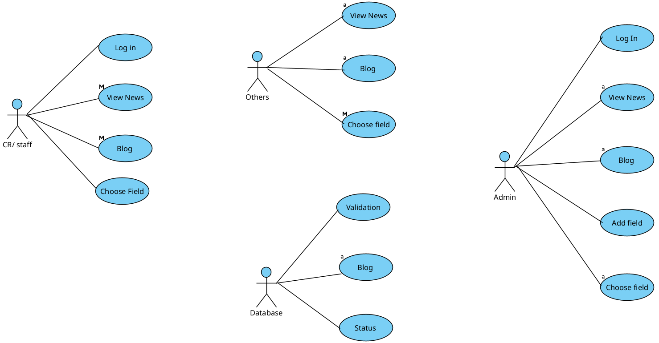
Use for actors

Slide 5
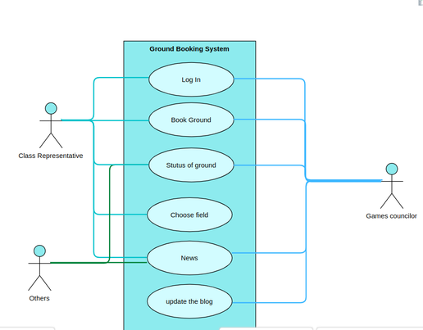
Use Case
1st phase:

Slide 6
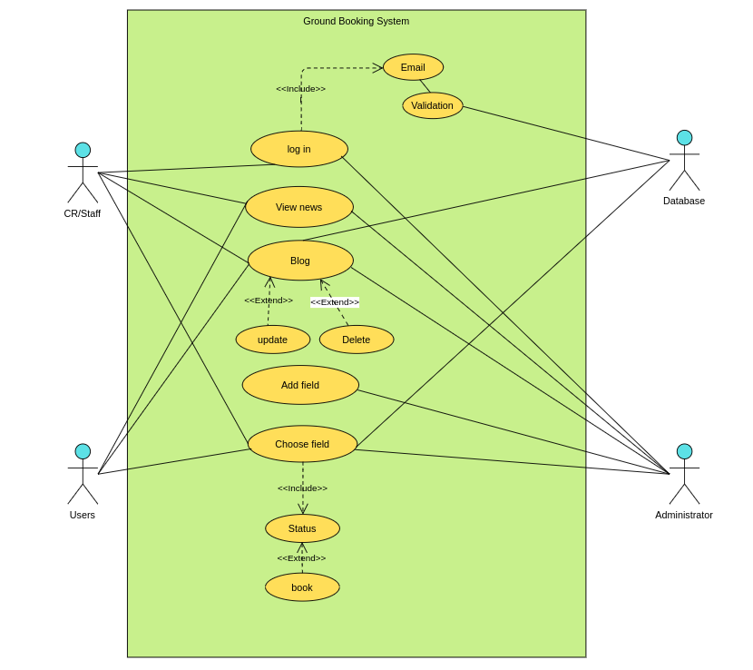
Refined use case

Slide 7
Project Specification
Log In
Summary: This use case enables the user to login to the system and interact in various ways with the system.
Actors: Class representatives, Administrator or one of the staff, database.
Assumption: The class representative will have to be registered into the system. The CR will be registered using their college email id and password.
Basic course of events:
Go to logIn page
Enter email and password and choose the class
Database will validate entered email.
Log in confirmation will be sent.
Precondition: Class representative or staff is registered to the system.
Postcondition: The class representative and staff will be shown the display screen of the system if they log in with a registered email id and its corresponding password.
Non- functional requirements: The system should verify and validate the email within 5 seconds.

